Slide 1
Low Code Pipeline

Slide 2
Graph

Slide 4
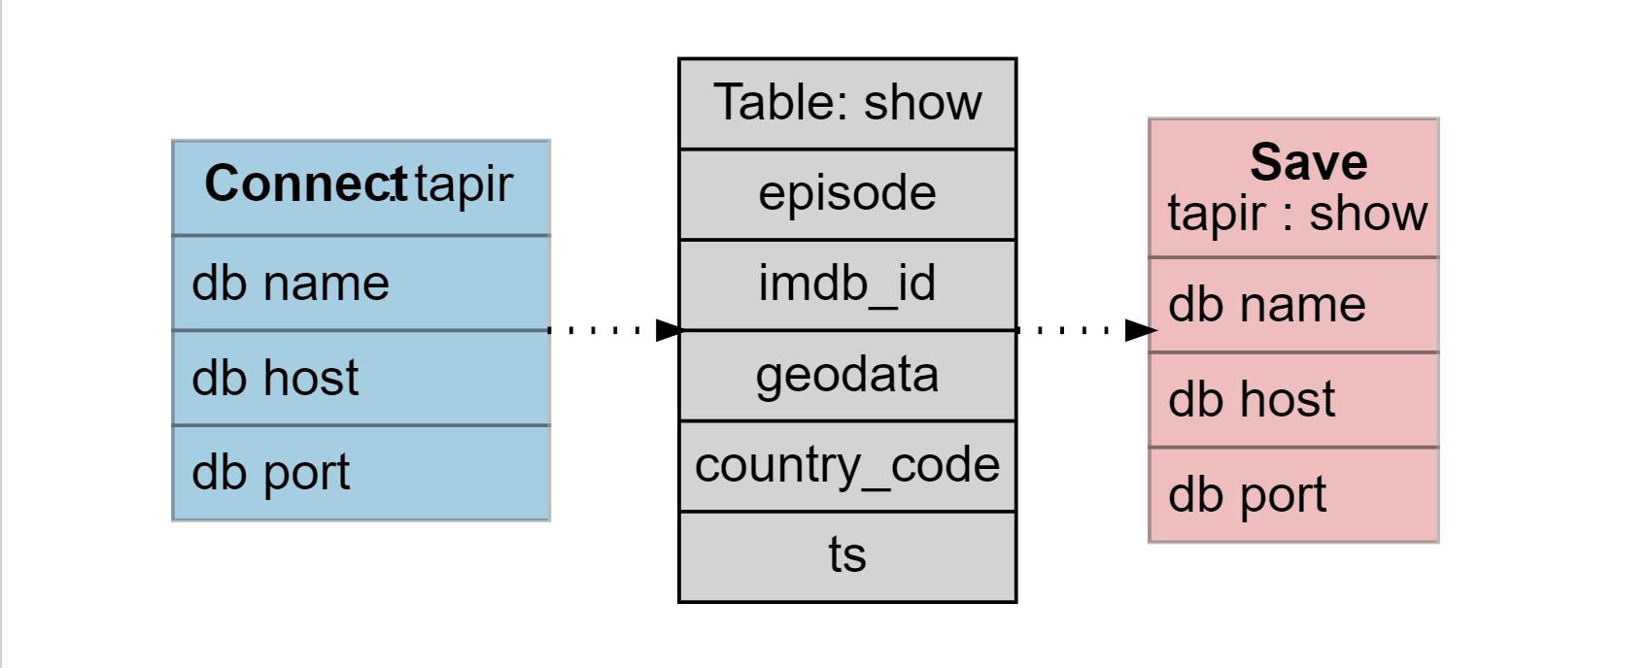
Ingest Tapir
S3 file

Slide 5
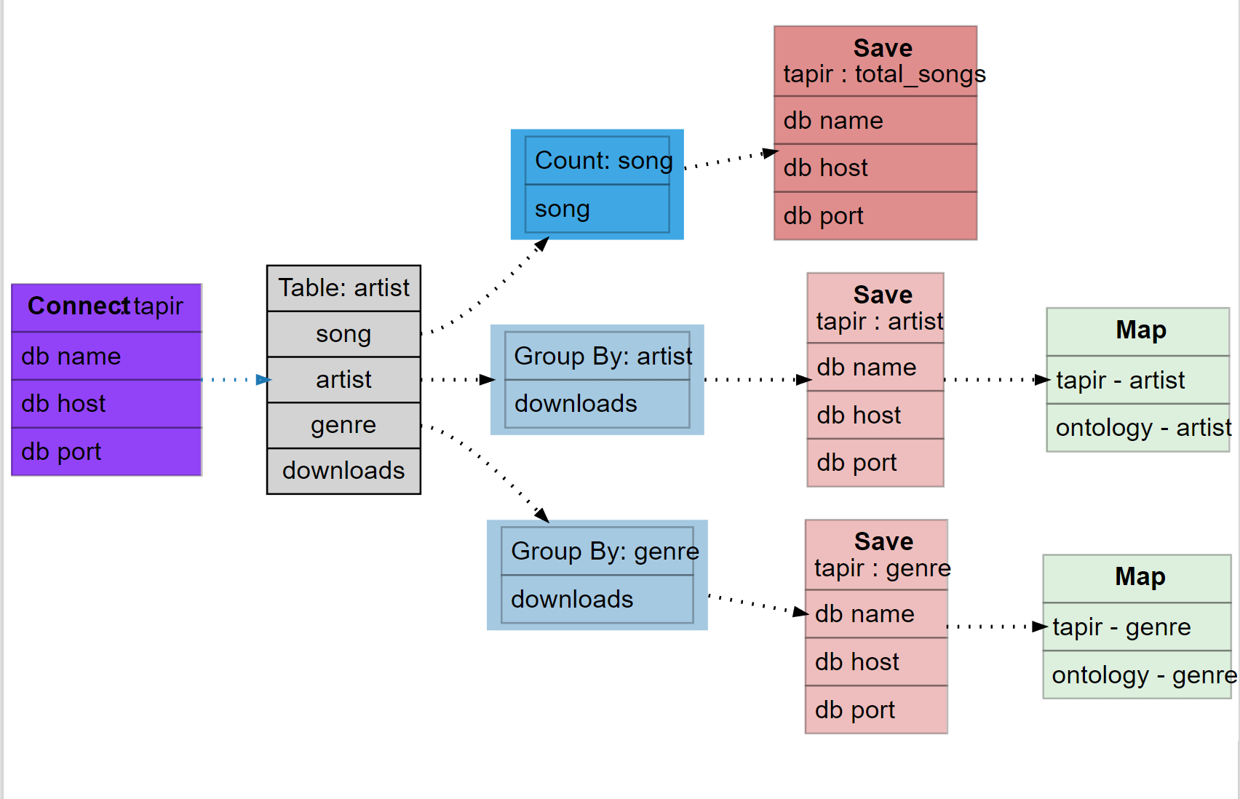
More complicated example

